Slide 1
Progressive Web Apps
Faisal Ahmed Khan
Rithesh Girish Gowda

Slide 2
1. Intro
Progressive Web Apps are experiences that combine the best of the web and the best of apps.
As the user progressively builds a relationship with the app over time, it becomes more and more powerful.
It loads quickly, even on flaky networks, sends relevant push notifications, has an icon on the home screen, and loads as a top-level, full screen experience.

Slide 3
2. Characteristics
A Progressive Web App is:
Progressive
Responsive
Connectivity independent
Fresh
App-like
Safe
Installable

Slide 4
3. Getting Set Up
The initial code for development:
https://github.com/googlecodelabs/your-first-pwapp/archive/master.zip
Codelab is designed to work well with the Chrome Web Server(Available as extension on chrome store)
Lighthouse is an open-source, automated tool for improving the quality of web pages.
Install and run the Node command line tool
npm install -g lighthouse
lighthouse <url>

Slide 5
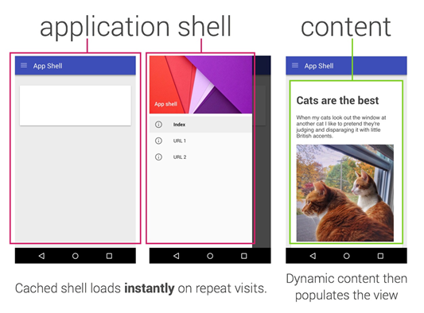
4. Architect Your App Shell
The app's shell is the minimal HTML, CSS, and JavaScript

Slide 6
5. Use service workers to pre-cache the App Shell
1. Register the service worker if it's available
2. Cache the site assets
3. Serve the app shell from the cache

Slide 7
6. Use service workers to cache the data
1. Intercept the network request and cache the response
2. Making the requests
3. Get data from the cache

Slide 8
7. Support native integration
Web App Install Banners and Add to Home screen for Chrome on Android
Tell the browser about your manifest file

Slide 9
8. Demo
If everything goes well this is how it looks.

Slide 10
9. Summary
1. Faster load time even on slow network conditions
2. Reduced file size on your device compared to native app
3. Secure, makes use of HTTPS instead of HTTP

Slide 11
10. References
https://developers.google.com/web/progressive-web-apps/
https://developers.google.com/web/fundamentals/app-install-banners/
https://developers.google.com/web/tools/lighthouse/
https://developers.google.com/web/progressive-web-apps/checklist
https://developers.google.com/web/fundamentals/security/encrypt-in-transit/why-https

